Slide 1
LACE Index
Implementation and deployment
Presented by Jay and William
pleyte@ohsu.edu
Chan_William@email.com

Slide 2

Agenda
What is L.A.C.E?
Opportunities
Solutions
Implementation Plan
Project Team

Slide 3
Agenda
What is L.A.C.E?
Opportunities
Solutions
Implementation Plan
Project Team

Slide 4




What is LACE?
LACE was developed by Dr. Walraven¹ and team in 2010 to predict the patients’ risk of readmission post discharge from 30-day.
LENGTH OF STAY
duration of patients spent in the hospital from point of admission
longer duration can due to complexity of the health illnesses
ACUITY OF ADMISSION
captures the patients admitted to the hospital from ED
higher acuity patients require more clinicians attentions
COMORBIDITY
the presence of two or more diseases from a patient
multiple diseases can create complication within healthcare management
EMERGENCY DEPARTMEBNT
the frequency when patients have visited the ED
high ED utilizers might mean poor health conditions
http://www.cmaj.ca/content/182/6/551

Slide 5
Agenda
What is L.A.C.E?
Opportunities
Solutions
Implementation Plan
Project Team

Slide 6



Opportunities
Discharge starting on 10/2012, CMS launched a Hospital Readmission Reduction Program (HRRP) which will withhold 3% reimbursement if exceeding the Excess Readmission Ratio (ERR)¹
According to a study from Dr. Shah et al in January 2018, the team surveyed 6,880 patients to capture their socioeconomic and readmission status.¹ A second study focused on how much labor cost savings from 30-day readmission pilot program².
Cost of Stay
$3,808
Length of Stay
2 Days
Labor Cost
+$20/hr
https://www.sciencedirect.com/science/article/pii/S0002914918303862
http://insights.patientbond.com/blog/reduce-hospital-readmissions-and-labor-costs-how-its-possible

Slide 7
Agenda
What is L.A.C.E?
Opportunities
Solutions
Implementation Plan
Project Team

Slide 8
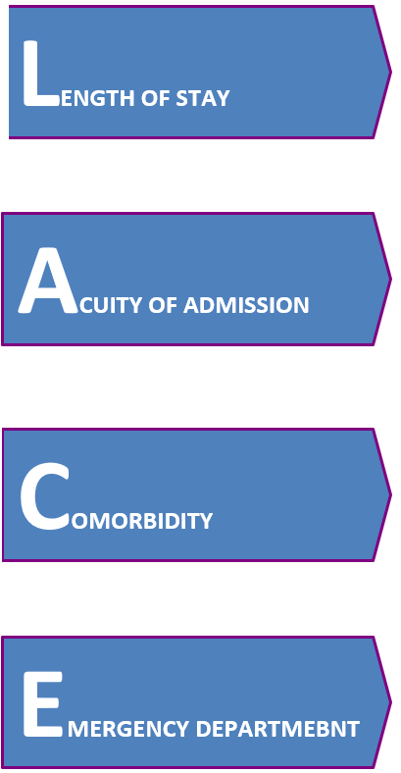


Solutions
Implementing the LACE application using logistic regression with accuracy of 82%. The regression is much simpler to explain and translate into operations.
Logical flow of the algorithm
Congestive heart failure and mild liver disease
Logistic Regression
LACE Score
Patients readmitted in the past 30-day
Calculated LACE score at patient level will be in the EHR system
Clinicians are advised on the patients’ 30-day readmission risk
Patient encounters attribute scoring
Notes:
To identify patients at high risk for readmission or death within thirty days of discharge
we Developed a Logistic Regression which uses the LACE Index.
For the pilot project we only implemented two of the 15 comorbidities
We chose congestive heart failure and mild liver disease
As patient’s are discharged from the ER our model evaluates their risk of readmission and a flag is raised within the EMR software to indicate that some form of intervention is necessary.

Slide 9
Solutions
Explanations on why LACE variables and to demonstrate the accuracy of using this algorithm.
LACE variables were all selected due to increased accuracy with the designated threshold to maximize sensitivity to minimize patients who are discharged without being flagged as a readmission risk.
The algorithm produces 12% false positive (patients do not have readmit but were flagged) and 5% false negative (patients have readmit risk but were not flagged)
Factors | Threshold | Accuracy
Length of Stay | 0.225 | 80.7%
Acuity of Admission | 0.16 | 54.9%
Comorbidity | 0.152 | 71.9%
Emergency Department | 0.175 | 80.3%
LACE | 0.25 | 82.3%
LACE | 0.2 | 72.7%
LDA | n/a | 85.7%
CART | n/a | 85.7%
 | True Outcome
 | Patients do not have risk | Patients have risk
Patients do not have risk | 2437 | 154
Patients have risk | 364 | 68
Using all the LACE factors adequately identified patients we were at risk of readmission post 30-day from discharge.
Notes:
We developed our model by first looking at the individual effects of the LACE factors –
An important variable in the model is selecting the threshold which is the cutoff between who is considered high risk and who is not
Setting the threshold to one extreme will unnecessarily increase costs by classifying patients as high risk when they don’t need extra attention.
Setting it too far in the other direction will result in not contacting patients who need extra attention.
We want to err on the side of false positives
A 5% difference in the threshold had a 10% difference in accuracy.
We also tried machine learning LDA and CART
These methods are slower and with a produciton data set the increased load may

Slide 10
Agenda
What is L.A.C.E?
Opportunities
Solutions
Implementation Plan
Project Team

Slide 11
Implementation Plan
4 Month
6 Month
6 Month
6 Month
Prepare pilot site testing
Integrate LACE score with EMR database
Develop full set of LACE comorbidities
Add LACE functionality to EMR
Run pilot LACE program
Evaluate effective with physician champions
Refine on clinical workflow
Select the best contact options
Develop training plan
Pilot Evaluations
Evaluate impact
Recalibrate
Develop model maintenance plan
Full LACE model development
Evaluate final model effectiveness
Deploy LACE to enterprise
Execute change management plan
Workflow training and documentation
Program Milestone
Program Milestone
Program Milestone
Program Milestone
Notes:
Now that we have the details of our model worked out we can put all the elements together in to an implementation plan.
*box by box go over one item from each phase*
Add the LACE functionality to the EMR
Implement full list of comorbidities
Determine methods for intervention such as by phone, email, SMS, mobile app, or in-person clinic appointment.
Train the staff
Evaluate pilot results
Evaluate model effectiveness
Deploy LACE to all EMR instances.

Slide 12
Agenda
What is L.A.C.E?
Opportunities
Solutions
Implementation Plan
Project Team

Slide 13
Project Team
Care Delivery Leadership
Program Sponsor
Steering Committee
Analytics Lead
Clinical Lead
Analytics SMEs
Project Leadership
Clinicians
Business Analysts
Data Modeler
Data Engineer
Physicians
Nurses
Informaticists
Educators
Analytics Lead
Clinical Lead
Notes:
Identify a sponsor
Put together the team
Create a roels and responsibility matrix

Slide 14
Thank you! Q & A

